Slide 1

Machine Learning: Analyzing and Modeling Marketing Campaign Data
Team: Wa-Kaggle ForeveR
Mariangel Mora, Komal Patel, Alex Turnure, Chris Roy

Slide 2
Data source and modeling goal
Marketing campaign data: https://www.kaggle.com/datasets/rodsaldanha/arketing-campaign
The objective of our modeling efforts were to predict whether or not a customer would accept/ redeem an offer promoted by a marketing campaign. Generally, the goal of the model is to help drive an increase in total transactions, even if those transactions are at a slightly reduced margin, to produce an overall increase in revenue.

Slide 3
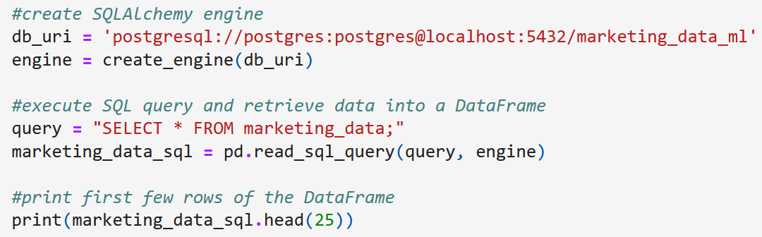
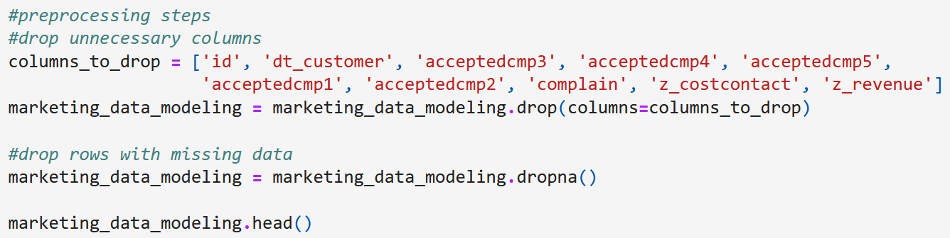
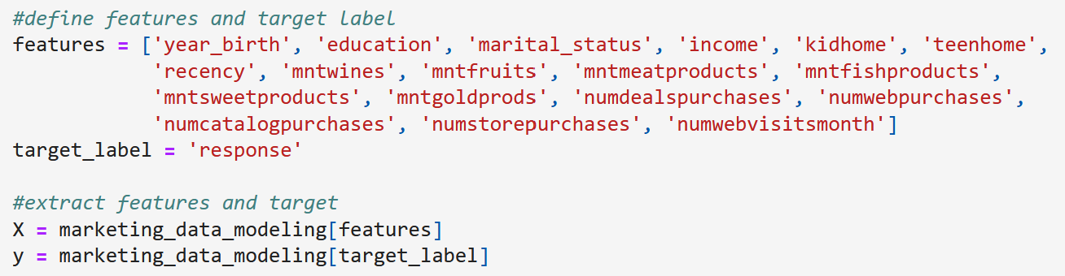
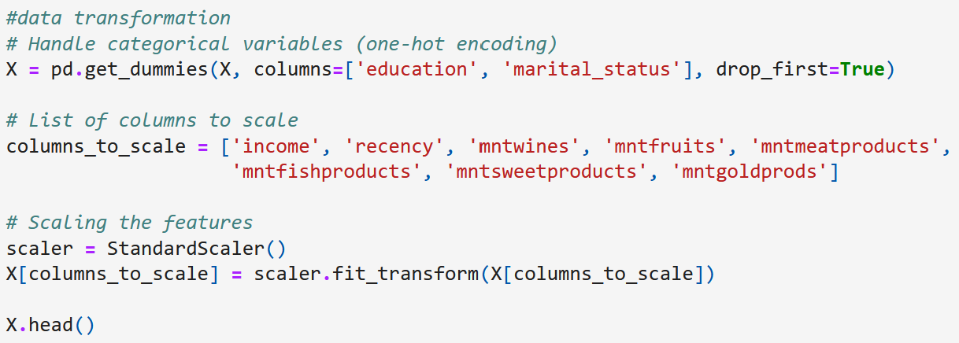
Initial feature selection & data processing
Data is read from a PostgreSQL DB to an ipynb file via SQLAlchemy
Unneeded columns and rows missing values are dropped
Features and targets are defined, and then mapped to X and y variables, respectively
Categorical values are encoded, numerical values with larger variance are scaled via standardScaler

Slide 4
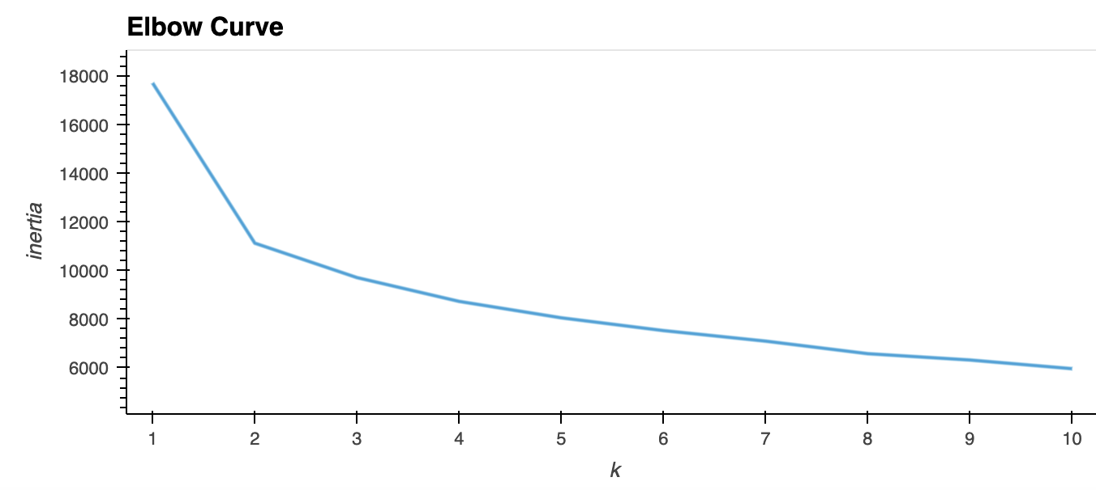
Unsupervised Learning Model
Initiated K-means clustering analysis for unsupervised learning
Elbow curve resulted in two clusters, concluding that the K-means clustering is insignificant to proceed further with unsupervised learning

Slide 5
Supervised Modeling Approaches
Baseline
Random Forest
Neural Network
Logistic Regression
K-Nearest Neighbors

Slide 6
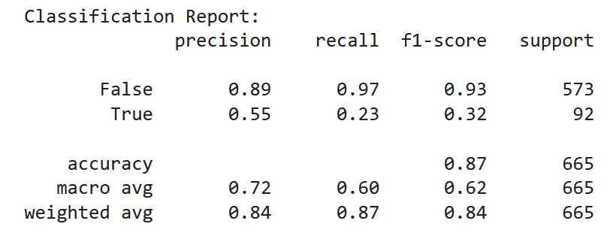
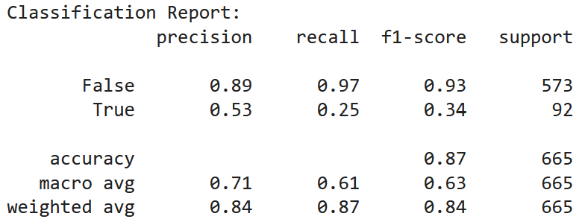
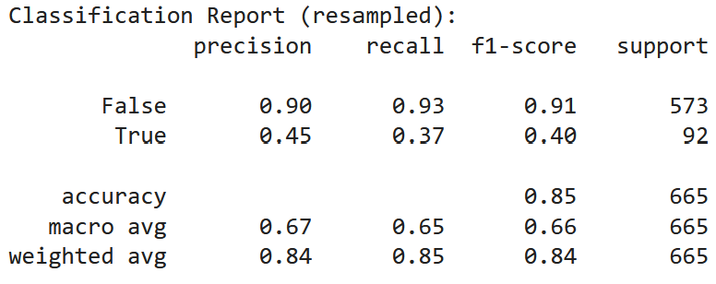
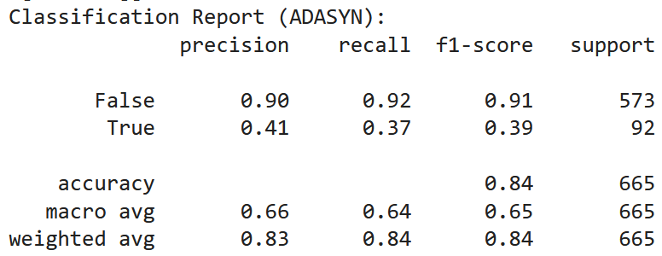
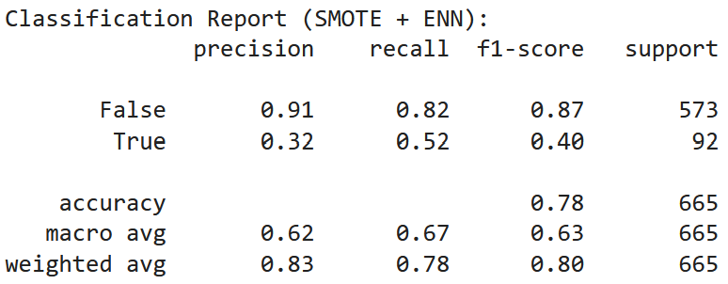
Random Forest model
Model code
Run breakdown:
1: standard random forest
2: gridSearchCV
3: SMOTE + class weight adjustment
4: ADASYN (oversampling)
5: SMOTE + undersampling

Slide 7
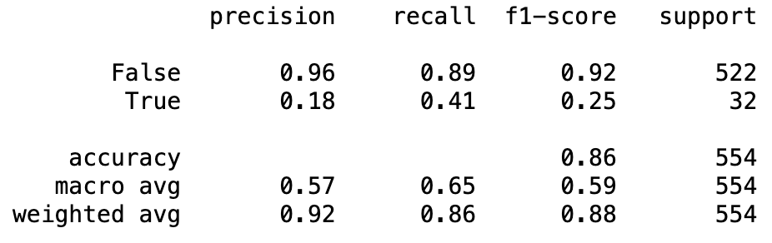
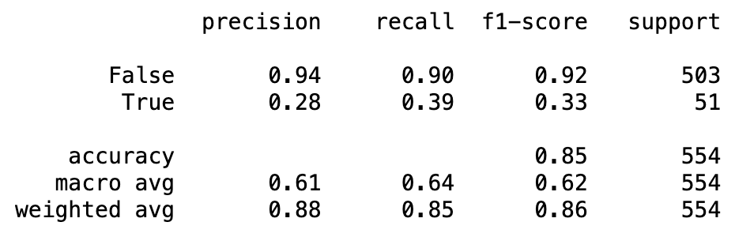
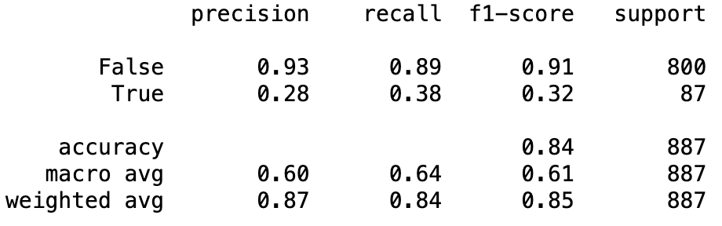
K-Nearest Neighbors (KNN) Model
KNN uses proximity to make classifications or predictions about the grouping of data points
Model accuracy (outcomes):
Baseline: 86%
Reduction of features: 85%
Increasing test size and reduction of features: 84%
Note: LabelEncoder() applied in preprocessing step for KNN model

Slide 8
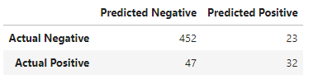
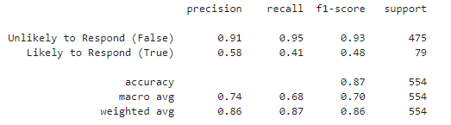
Logistic Regression Model
Creating the Original Baseline Model
Utilizing the original cleaned data for continuity and comparability between models (subject to change in further optimization).
One-hot encoded relevant categorical data and scaled relevant numerical data.
Followed standard procedure to split and fit the model for optimization (Note: max_iter was set to 1000 because default 100 was not enough iterations for the algorithm to converge).
Results of first LR Model shown to the right.
Confusion Matrix
Classification Report

Slide 9
Logistic Regression Model Optimization
First Optimization: Threshold Manipulation
Utilized the .predict_proba function instead of .predict from the sklearn package.
This function allows users to manipulate the decision threshold that determines the cutoff point for assigning class labels.
Default is typically 0.5 (classes are typically 0 and 1)
Set to 0.39: resulted in 87% accuracy and a more balanced spread across precision and recall.
Second Optimization: ANOVA and Chi-Square Test
ANOVA was used to determine the most relevant categorical features (Started with 13 categories – narrowed down to 8)
Chi-Square test was used to determine the most relevant numerical features (Started with 16 – narrowed down to 8).
Resulted in 87% accuracy, but a low recall rate for Response = True.

Slide 10

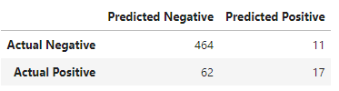
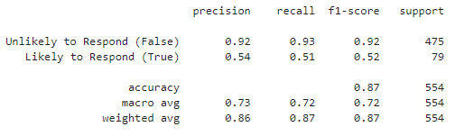
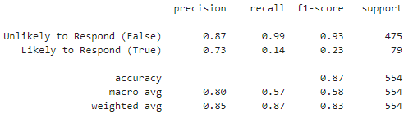
Logistic Regression Model Optimization Results
First Optimization: Threshold Manipulation
Second Optimization: ANOVA and Chi-Square Test
Confusion Matrix
Confusion Matrix
Classification Report
Classification Report

Slide 11
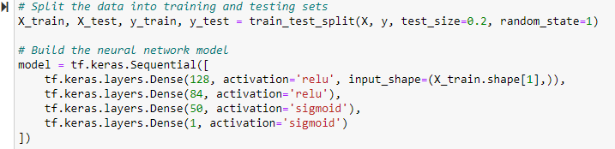

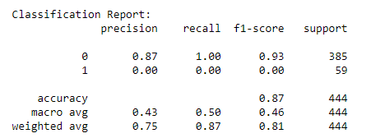
Neural Network Model
1. Default features
0 False (no offer redemption)
1 True (offer redemption)
The first model struggles significantly with the minority class (Class 1), failing to classify any instances correctly.

Slide 12
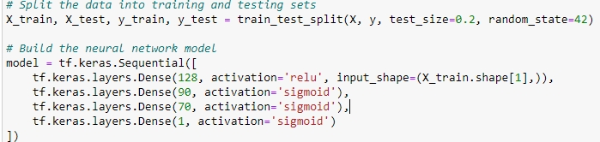


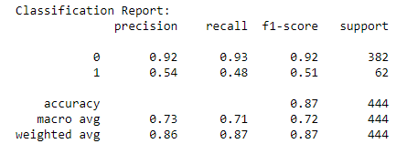
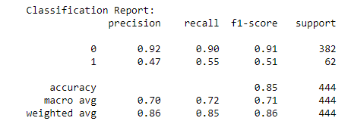
Neural Network Model (cont’d)
3. Keras tuner
2. First optimization
The second and third models show a balanced improvement, especially in handling the minority class, while maintaining high performance for the majority class.

Slide 13
Conclusion
Based on the supervised learning models tested for the sample marketing campaign data, the highest level of accuracy achieved was 87% from more than one model.
This concludes that several models can achieve the optimal result, no one model is best fit.
There were significant observable differences between precision, recall, and F1 throughout the various models, therefore, the business may want to consider the impact of these variations in accordance with their goals.

